Slide 1

LangChain & LangGraph Workshop
Building AI-Powered Applications with Language Models.
Presented by: Ramachandra Udupa.
14/02/2025, SMVITM Bantakal.

Slide 2

Workshop Agenda
1
Introduction to Language Models
2
Overview of LangChain and LangGraph
Understand their impact.
Explore key features.
3
Hands-On: Web Search Integration
4
Retrieval-Augmented Generation (RAG)
Practical application.
Advanced techniques.

Slide 3
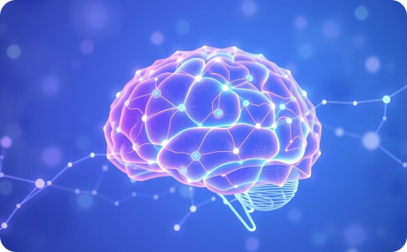
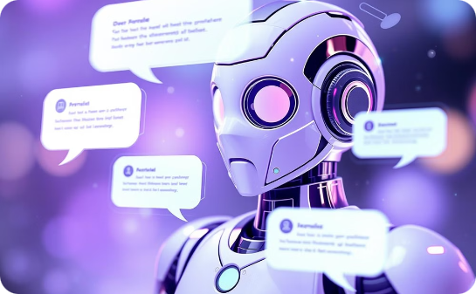

What are Language Models?
Why They Matter
Impact on Industries
Statistical and neural models that understand human language through complex algorithmic connections
Revolutionizing content creation, chatbots, and Q&A systems with intelligent communication
Transforming research, business, and creative fields through advanced language understanding

Slide 4
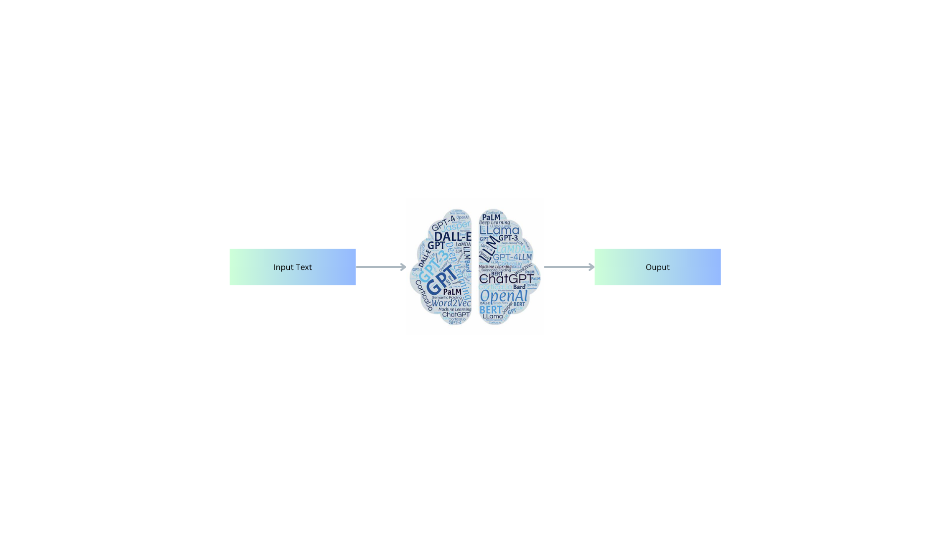
Fig: LLM

Slide 5
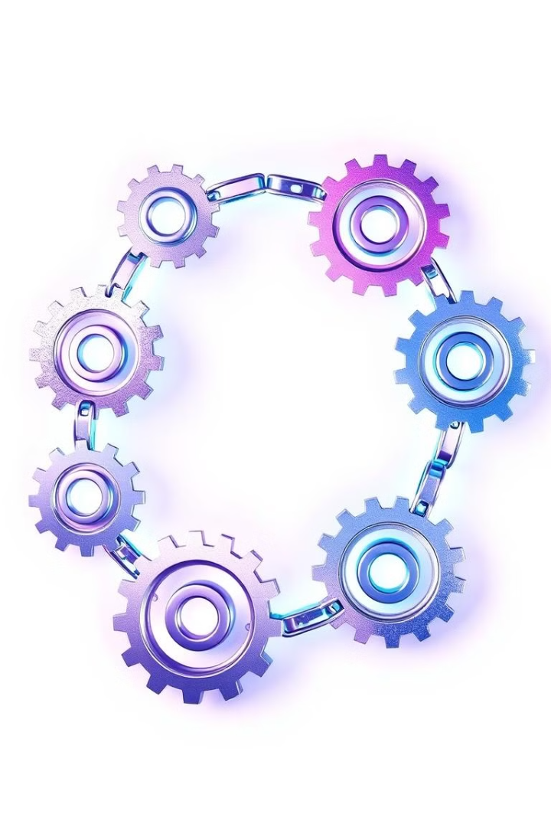
What is LangChain?
Definition
Key Features
An open-source framework that simplifies the development of applications powered by large language models (LLMs) by providing a standard interface for model integration and interaction.
Workflow Structuring: Organizes complex tasks into directed graphs, where nodes represent individ
Use Cases
Chatbots, data extraction, summarization.

Slide 6
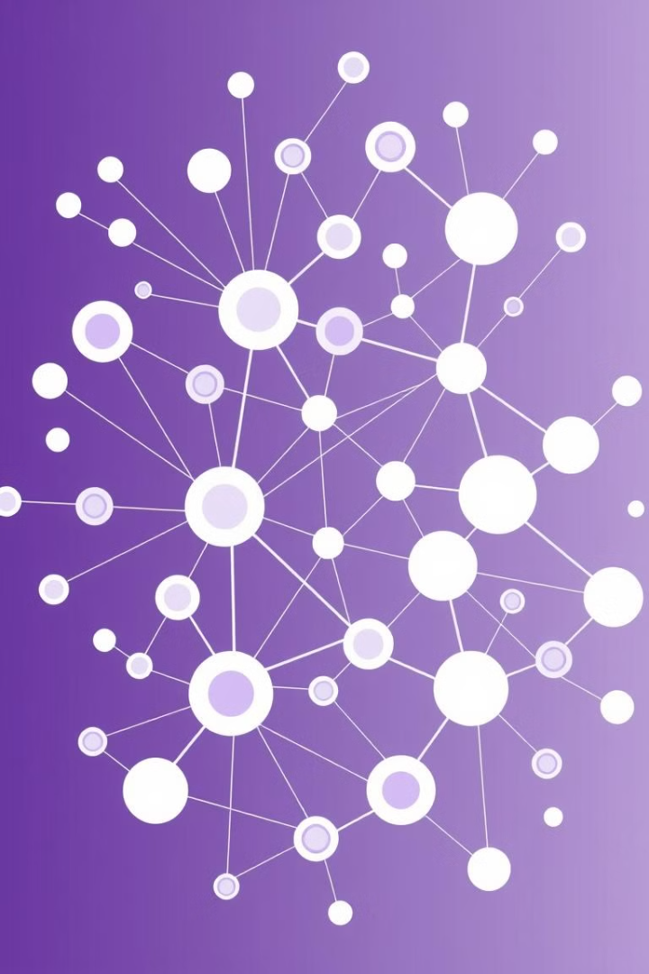



What is LangGraph?
Definition
Benefits
Comparison
An open-source library designed to construct stateful, multi-agent workflows using LLMs, structuring applications as directed graphs for enhanced control and persistence.
Visual debugging of workflows.
Complements LangChain with visualization.

Slide 7

Why Use These Tools?
Rapid Prototyping
1
Quickly build and iterate on LLM applications.
2
Flexibility
Combine multiple tools seamlessly.
Enhanced Capabilities
3
Leverage chaining and memory management.
4
Community & Ecosystem
Active development and support.

Slide 8
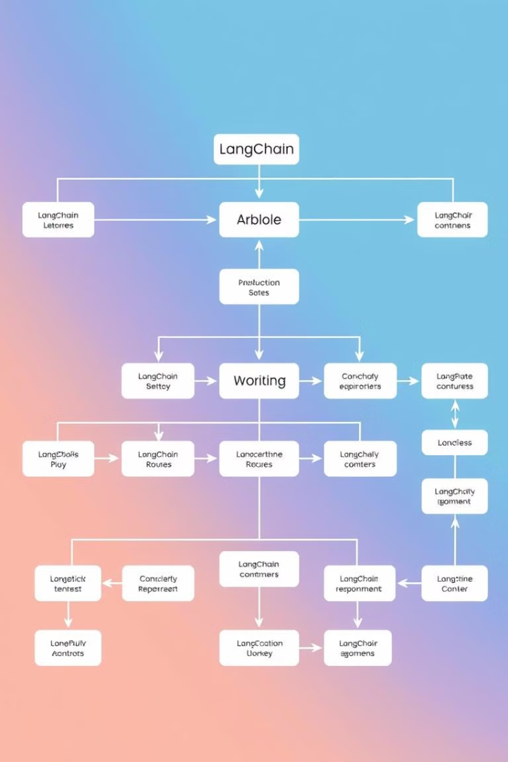

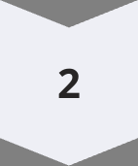
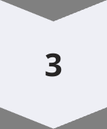
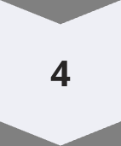
LangChain Architecture & Components
LLM Wrappers
Interface with language models.
Chains
Sequences of calls or actions.
Prompt Templates
Standardize inputs.
Memory Modules
Maintain state.

Slide 9
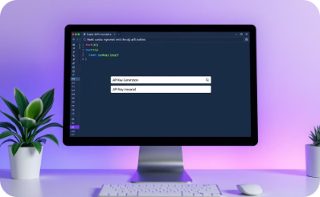
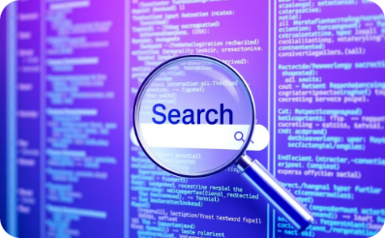
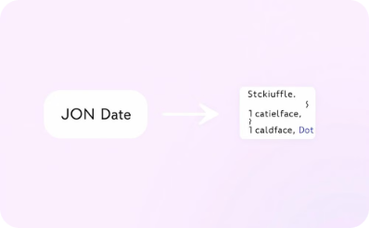
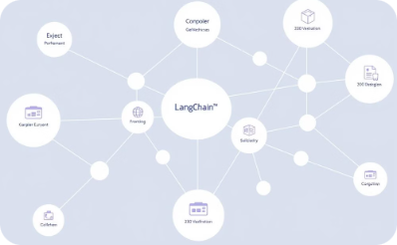
Hands-On Session 1 – Web Search Integration
API Setup
Search Request
Result Parsing
Chain Integration
Obtain an API key for a web search service like SerpAPI, Bing, or Google Search API.
Make a search request to the API, including your query and any necessary parameters.
Parse the returned results into a format suitable for integration into your LangChain application.
Integrate the parsed results into your LangChain chain, providing the LLM with real-time information.

Slide 10

Hands-On Session 2 – Retrieval-Augmented Generation (RAG)
What is RAG?
Retrieval-Augmented Generation (RAG) combines document retrieval with LLM generation.
RAG grounds LLM outputs in factual information retrieved from a data source.
It enhances the accuracy and transparency of LLM-powered applications.

Slide 11
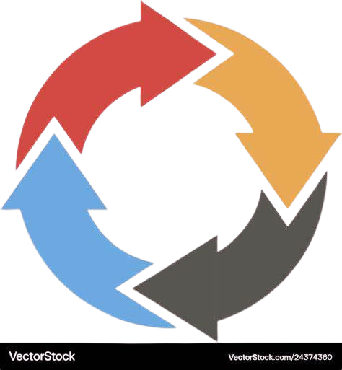
Best Practices & Tips
Prompt Engineering
Debugging
Experiment with formats.
Log outputs, use visual tools.
Performance Optimization
Security & Ethics
Monitor API usage, cache queries.
Secure API keys, verify sources.

Slide 12
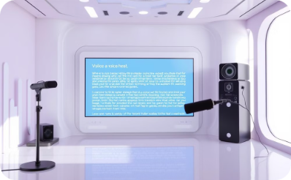
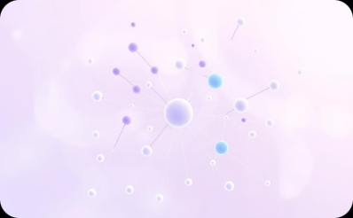
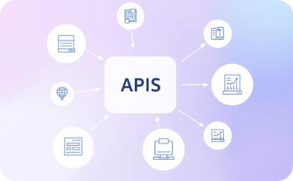

Advanced Use Cases & Future Directions
Multi-Modal Applications
Enhanced Memory
Integration
Community
Advanced techniques for AI systems to retain and contextualize information
Seamless connections between different AI tools and platforms
Global network of innovators driving AI technology forward
Expanding AI capabilities across different input and output formats

Slide 13

Conclusion & Thank You
Recap: LLMs, LangChain, LangGraph, web search, and RAG.
Contact me for questions.
Thank You!

